Slide 1
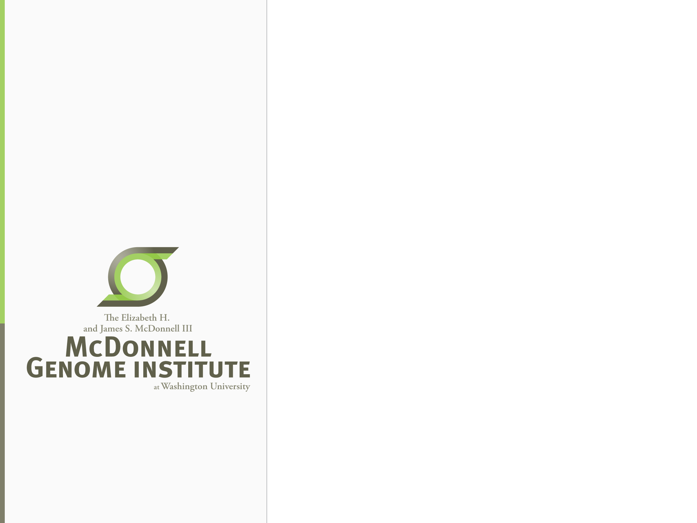
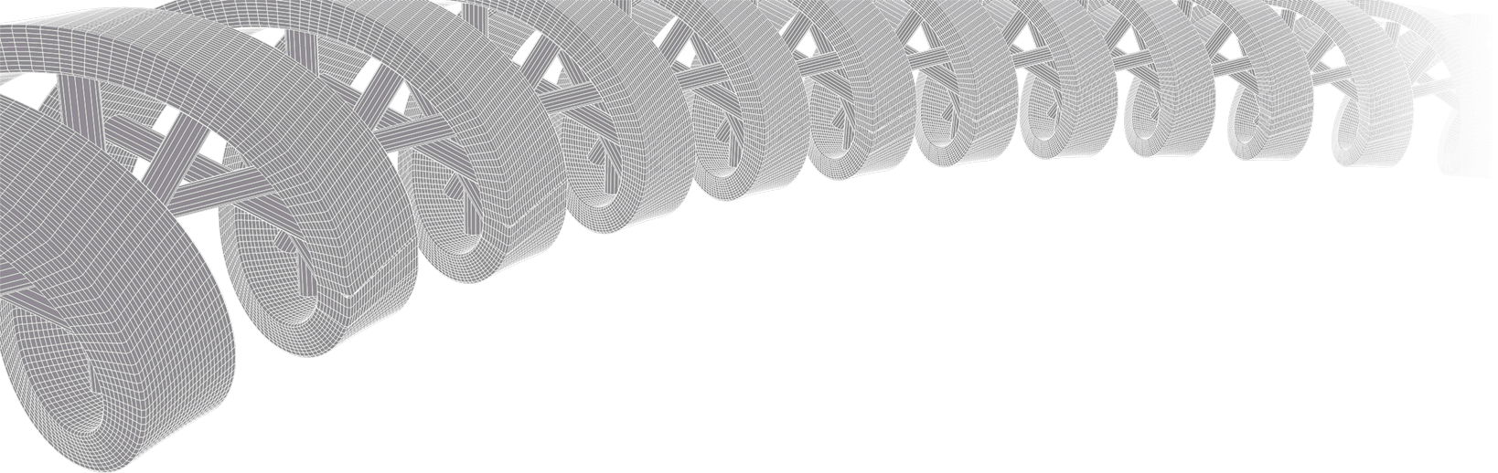

PMBIO Module 04 Germline. Germline WGS and Exome Variant Analysis
Malachi Griffith, Obi Griffith, Zachary Skidmore, Huiming Xia
Introduction to bioinformatics for DNA and RNA sequence analysis (IBDR01)
29 October – 2 November, 2018
Glasgow

Slide 2
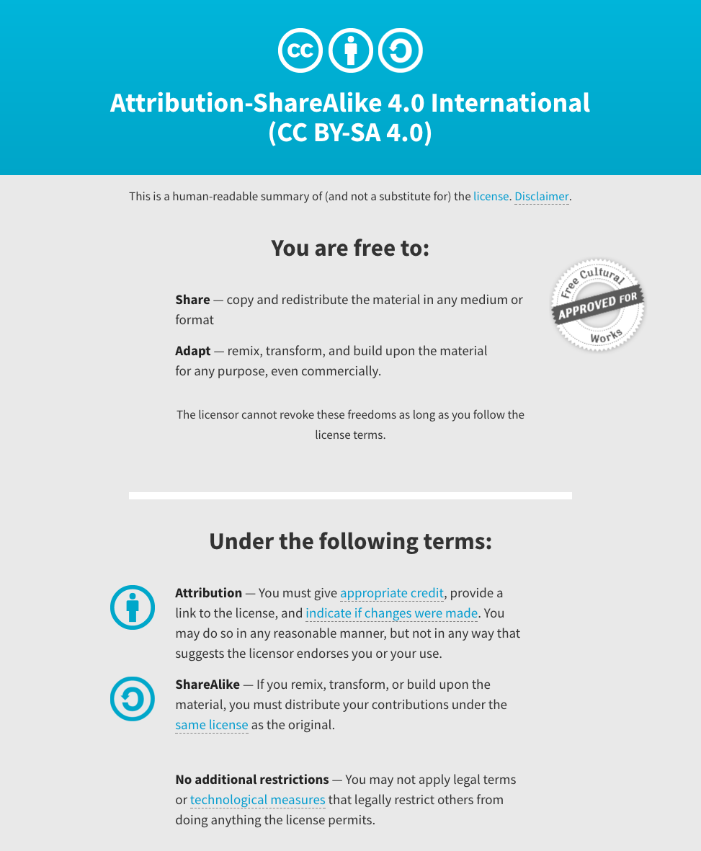
Notes:
Note there are two licenses if effect for this course.
All *content* (lectures, written materials, etc.) are made available under the Creative Commons Attribution-ShareAlike 4.0 International (CC BY-SA 4.0). (https://creativecommons.org/licenses/by-sa/4.0/).
All *code* (R scripts the website code itself) are made available under the MIT License (https://opensource.org/licenses/MIT).

Slide 3
Learning objectives of module 04: Germline
Key concepts: Variation, germline mutation, polymorphism, SNPs, variant databases, germline variant calling
Use of the GATK tool kit for variant calling
Perform basic germline variant filtering
Compare single sample germline variant calling to cohort based calling

Slide 4
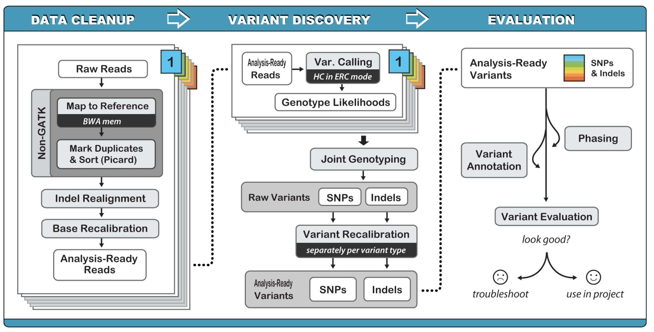
An example germline variant workflow
Slide courtesy of Karyn Meltz Steinberg (Washington University)

Slide 5
Different methods
Call SNVs and Indels separately by considering each variant locus
Very fast
Assumes bases are independent
Call SNVs and indels simultaneously via Bayesian genotype likelihood model
More computationally intensive
GATK UnifiedGenotyper
Call SNVs, indels and SVs simultaneously by performing a local de novo assembly
More computationally intensive
More accurate—gets rid of many false positives especially indels • GATK HaplotypeCaller

Slide 6
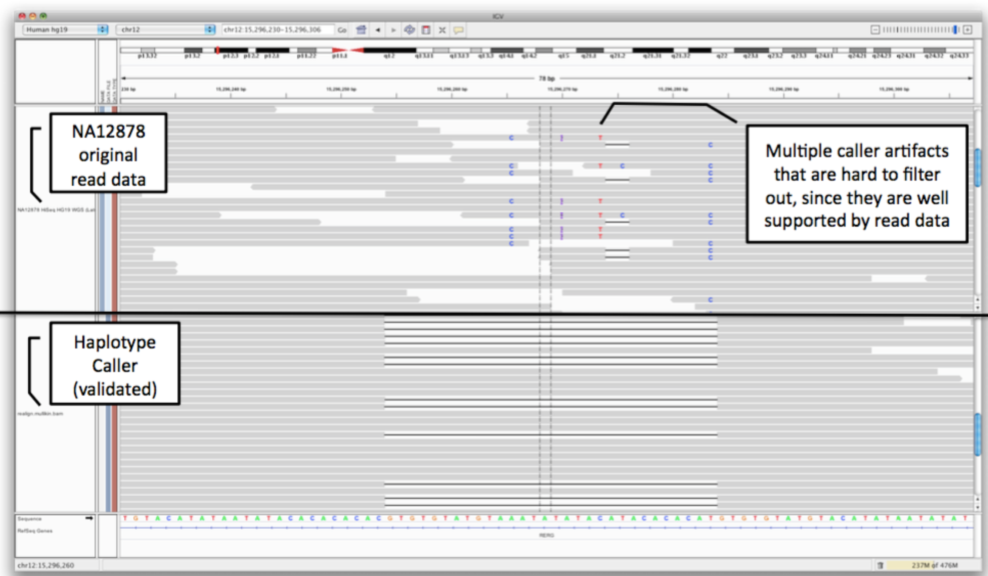
Why all the steps?

Slide 7
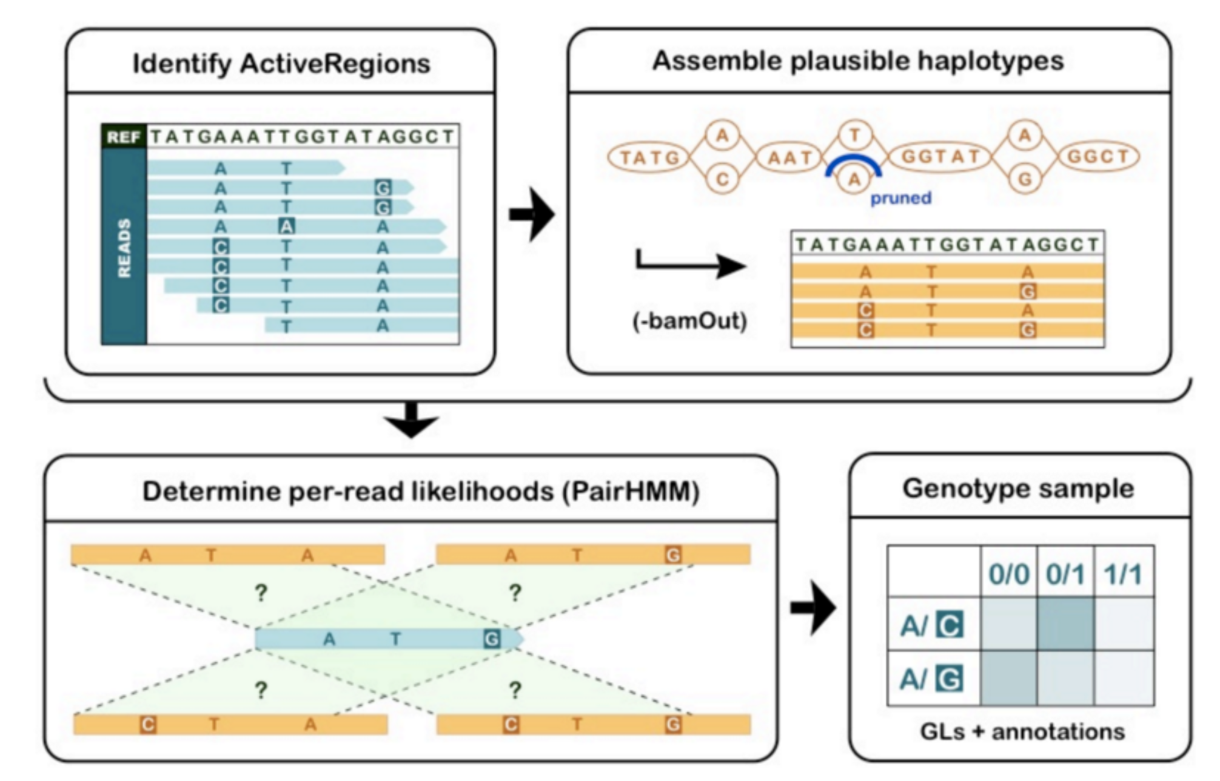
Haplotype caller illustrated

Slide 8
GATK recommended filters
SNPs
QD < 2.0 (variant quality/depth of non-ref samples)
MQ < 40.0 (Mapping quality)
FS > 60.0 (Phred score Fisher’s test pvalue for strand bias)
SOR > 3.0 (Strand odds ratio, aims to evaluate whether there is strand bias in the data—updated form of FET)
MQRankSum < -12.5 (mapping quality of reference reads vs alt reads)
ReadPosRankSum < -8.0 (distance of alt reads from end of the read)
Indels
QD<2.0
ReadPosRankSum < -20.0 • InbreedingCoeff < -0.8
FS > 200.0
SOR > 10.0

Slide 9
Variant Quality Score Recalibration (VSQR)
VariantRecalibrator
Gaussian mixture model by looking at the annotation values over a high quality subset of input call set and then evaluate all variants
ApplyRecalibration
Apply model parameters to each variant producing a recalibrated VCF file
Run these separately for SNPs and indels
Need to have some resource files to train the calibrator
HapMap
1000G
dbSNP

Slide 10
Variant evaluation

Slide 11
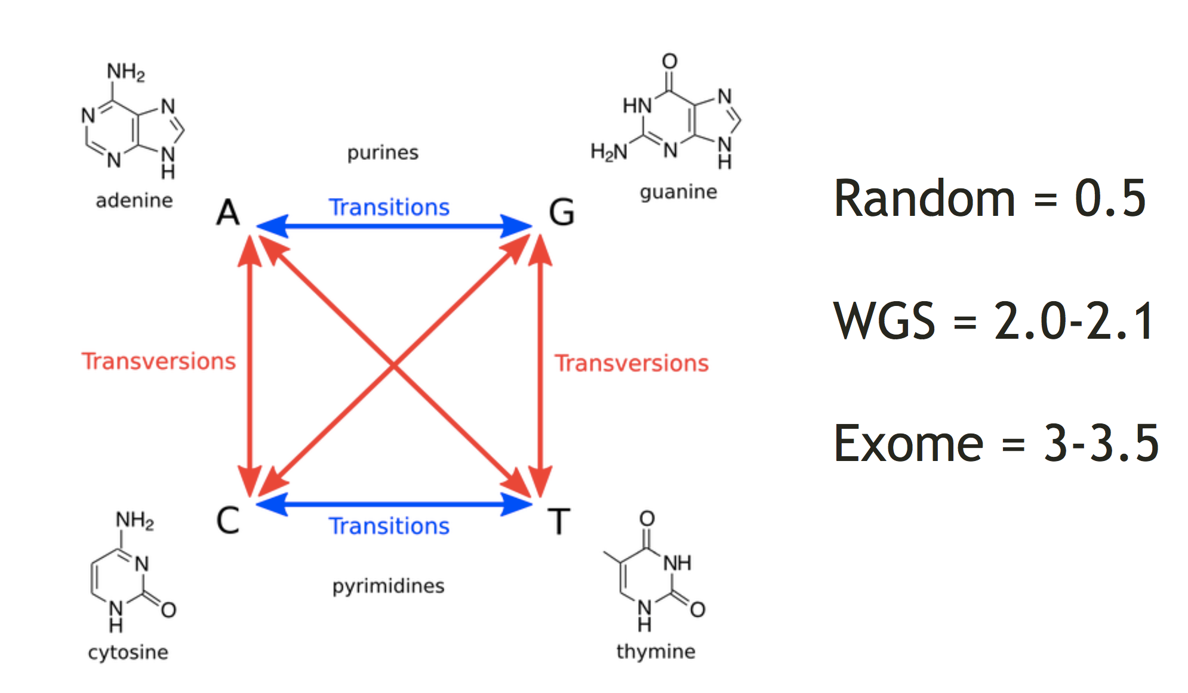
Transition/Transversion ratio (Ti/Tv)
Watch for major deviation from typical ratio

Slide 12
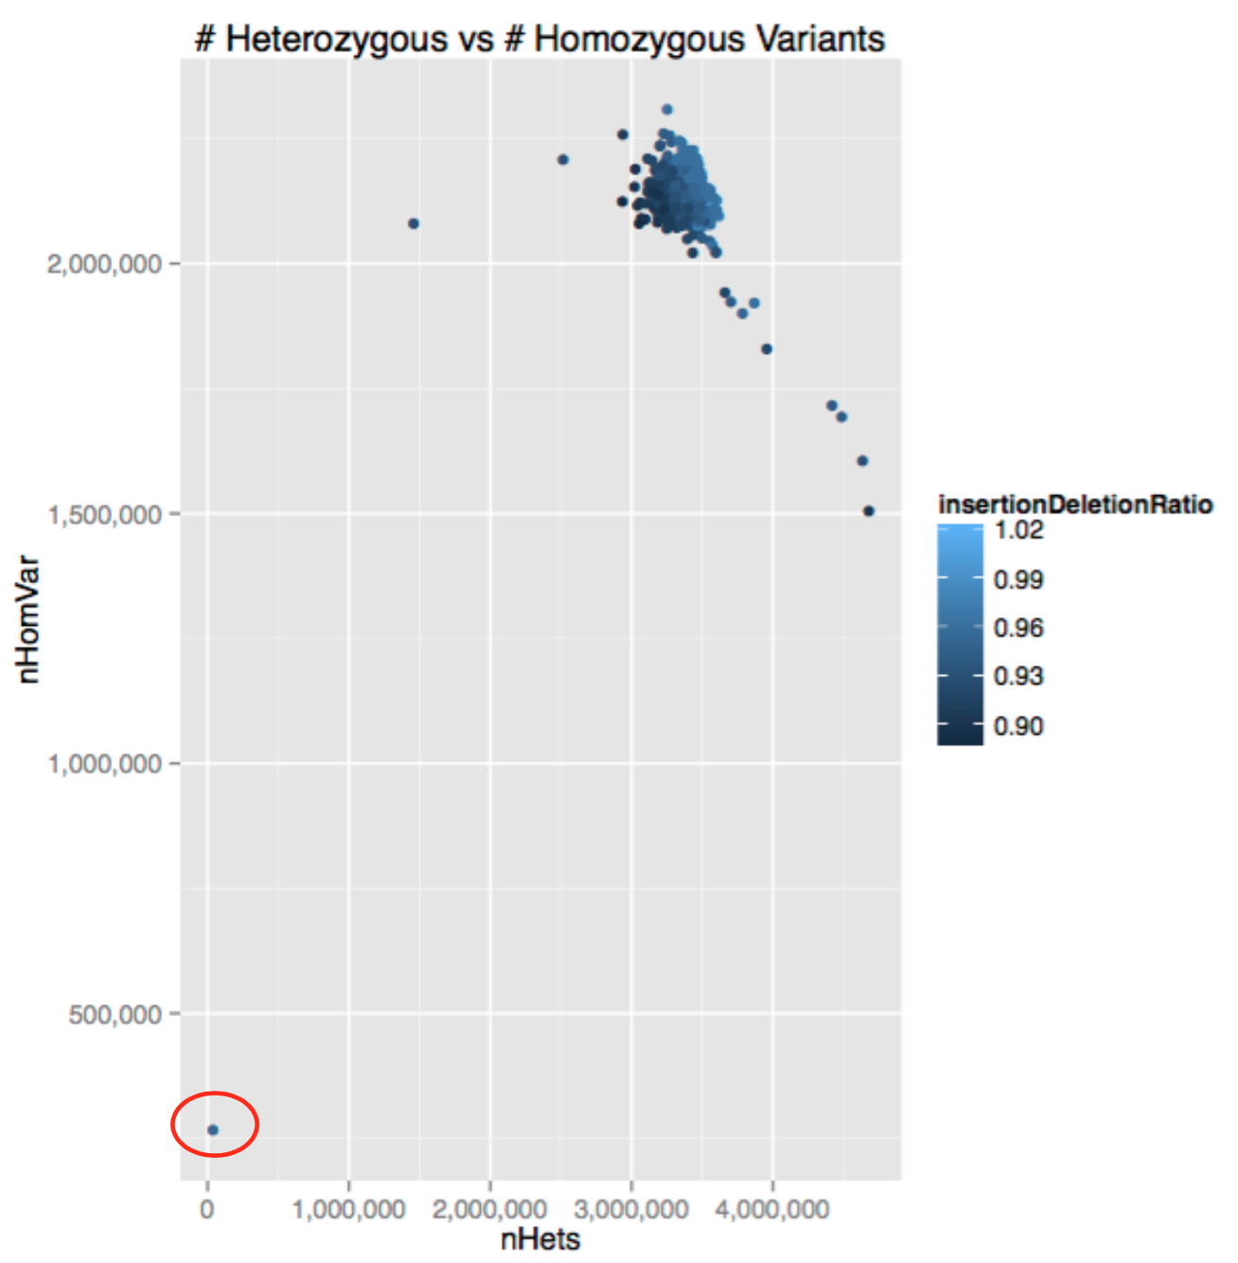
# heterozygous and homozygous variant
Watch for outliers …

Slide 13
Other things to evaluate
Sample swaps? Unexpected duplicates?
Sex check
Novel vs Known sites
dbSNP/1KG concordance (should be >98%) • Number of singletons per sample
excess singletons may indicate a bad sample
PCA
Is there significant population stratification?
Do you expect this?
What could be causing? Batch effects?

Slide 14
Germline variant annotation approaches/tool
VEP
Variant Effect Predictor
SIFT
Sorting Intolerant From Tolerant
SIFTpredictswhetheranaminoacidsubstitutionaffects
protein function
Given a protein sequence, SIFT chooses related proteins and obtains an alignment of these proteins with the query. Based on the amino acids appearing at each position in the alignment, SIFT calculates the probability that an amino acid at a position is tolerated conditional on the most frequent amino acid being tolerated. If this normalized value is less than a cutoff, the substitution is predicted to be deleterious
PolyPhen
Polymorphism Phenotyping
Predicts possible impact of amino acid substitution on structure and function of human protein using physical and comparative considerations
CADD
CombinedAnnotationDependentDepletion
Integrates multiple annotations into one metric by contrasting variants that survived natural selection with simulated mutations
GEMINI
Helps to aggregate and perform complex queries involving many variant annotations including those above

Slide 15
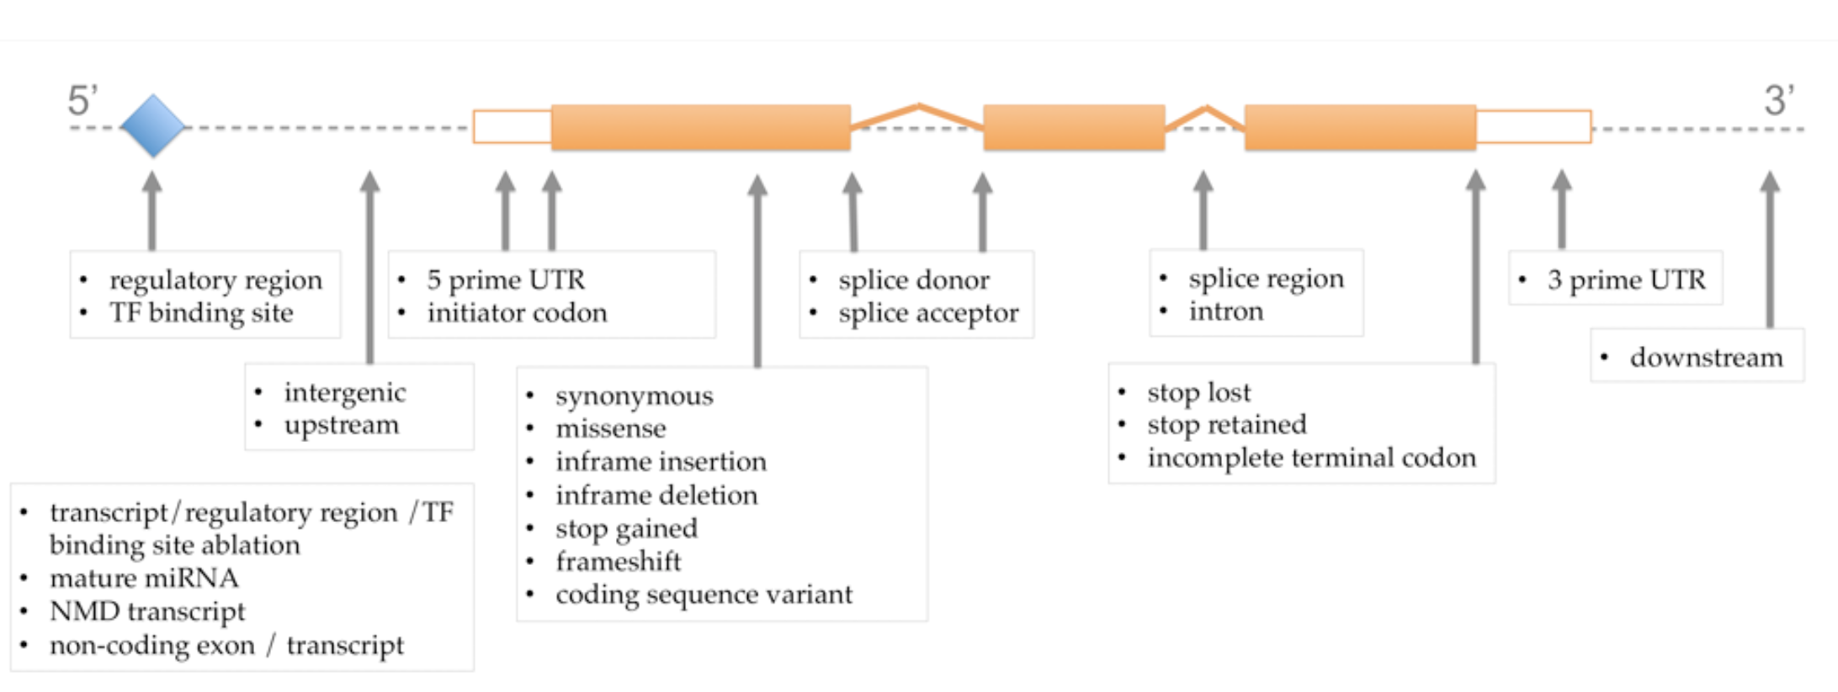
Functional categorization relative to transcript annotations

Slide 16
Personal anecdote on personal (direct to consumer) genomics

Slide 17
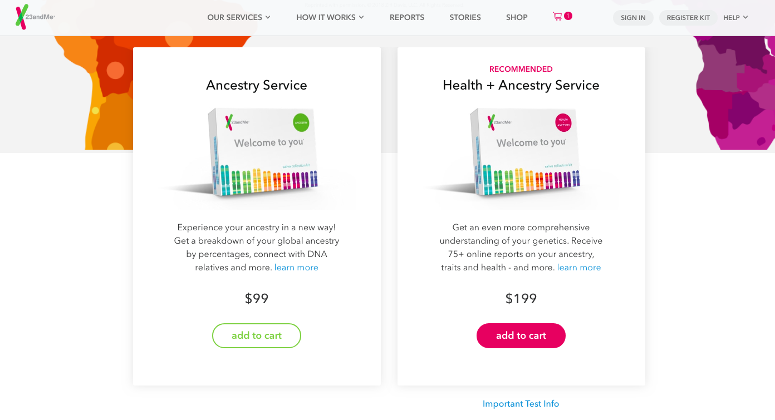
What is consumer genomics?
Direct-to-consumer genetic testing refers to genetic tests that are marketed directly to consumers. Also referred to as “at-home” genetic testing.
Provide access to a person’s genetic information without *necessarily* involving a doctor or insurance company in the process.
Our “ask your doctor …” culture blurs the lines between DTC and medically indicated products and services
Allows consumers to learn about ancestry, DNA relatives, genetic traits, health predispositions, family planning, etc, “on their own”.

Slide 18
Current Consumer Genomics options
Primarily genotyping but increasingly also some exome, whole genome, transcriptome and other options
Ancestry
Genotype-phenotype associations
Health risks
Early disease detection - intervention
Undiagnosed disease
Family planning
Precision medicine
Representative companies:
23andMe (DTC)
Ancestry.com (DTC)
Gene By Gene (DTC)
FullGenomes (DTC)
MyMedLab?
Color Genomics*
Genos*
Veritas*
HLI*
Illumina*
Counsyl*
Foundation Medicine*
Many more…
* Physician referral required
? Unclear if referral needed
Notes:
Sources:
George Church List: http://arep.med.harvard.edu/gmc/genome_services.html

Slide 19
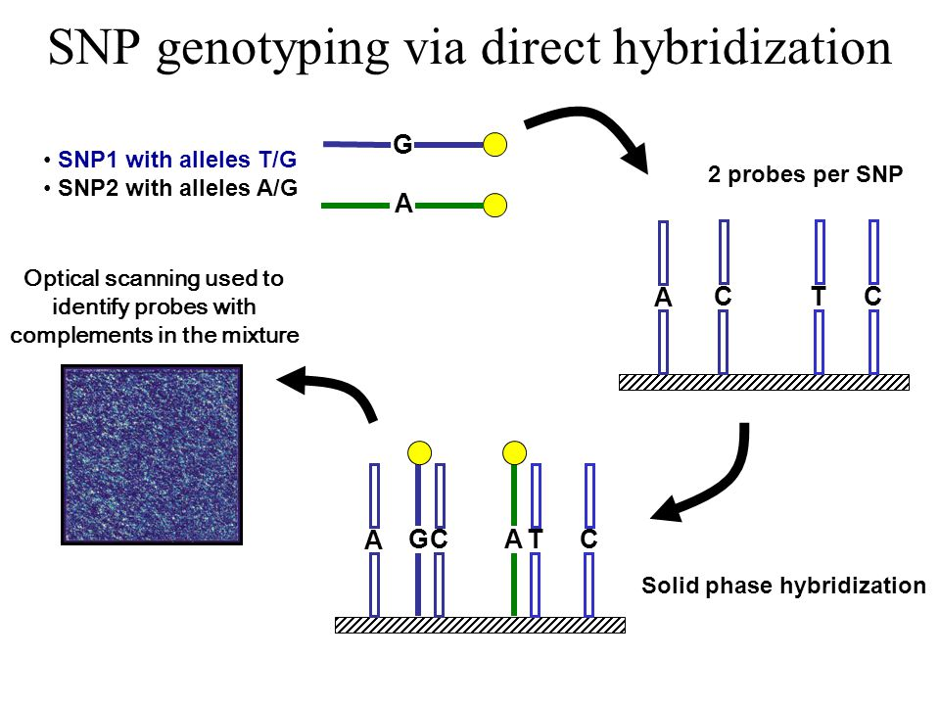
SNP array genotyping identifies likely genotype by hybridization

Slide 20
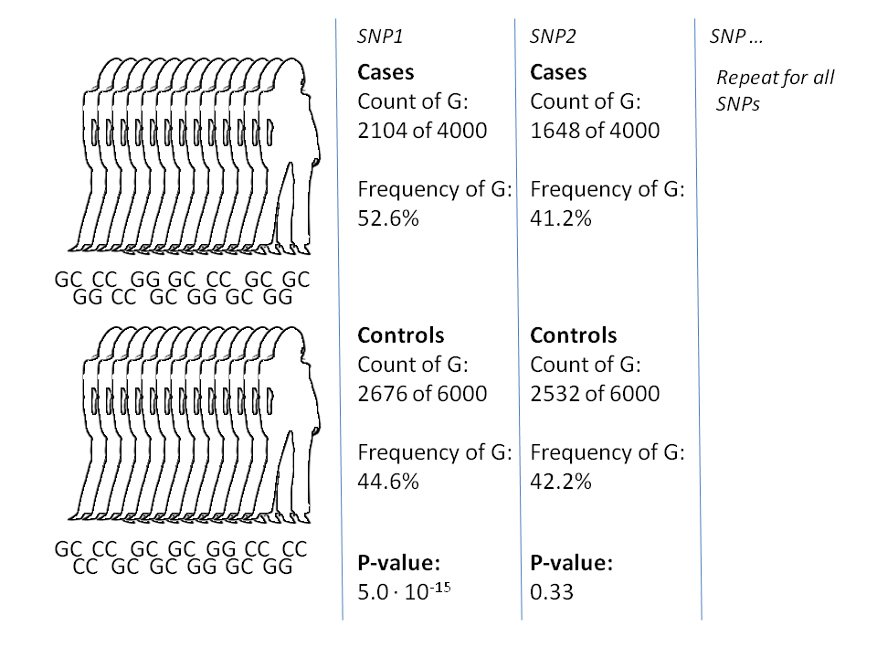
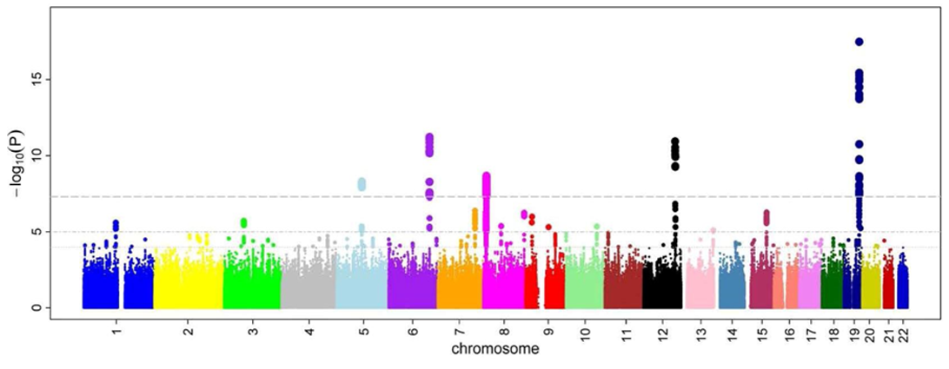
Inferred genotypes are intersected with known genotype-phenotype associations (GWAS studies)
The frequencies of specific alleles at SNP positions are statistically compared between cases and controls for a particular disease/trait
Many SNPs are scanned across the whole genome and significant loci identified
Thousands of such studies have now been completed

Slide 21
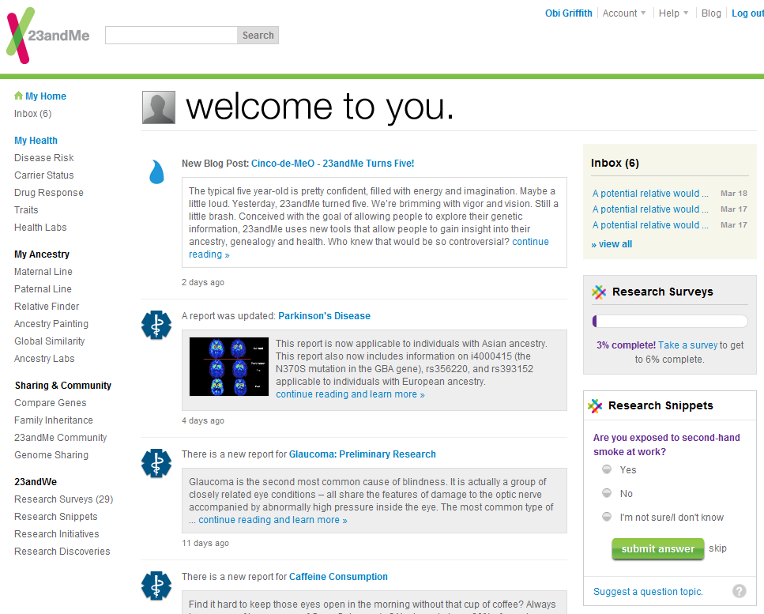
23andMe: Welcome to me
Health risks
Traits, etc
Potential relatives
Ancestry
Surveys
Sharing
Comparing
Snippets
Why did I do 23andMe? To compare similarities and differences with my fraternal (dizygotic) twin

Slide 22
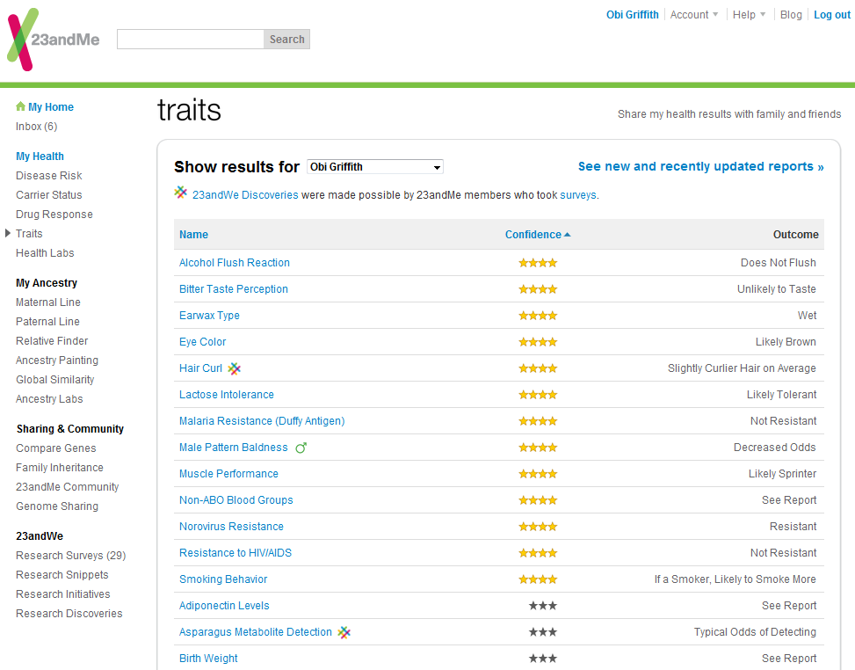
Traits: A “likely sprinter” with wet earwax

Slide 23
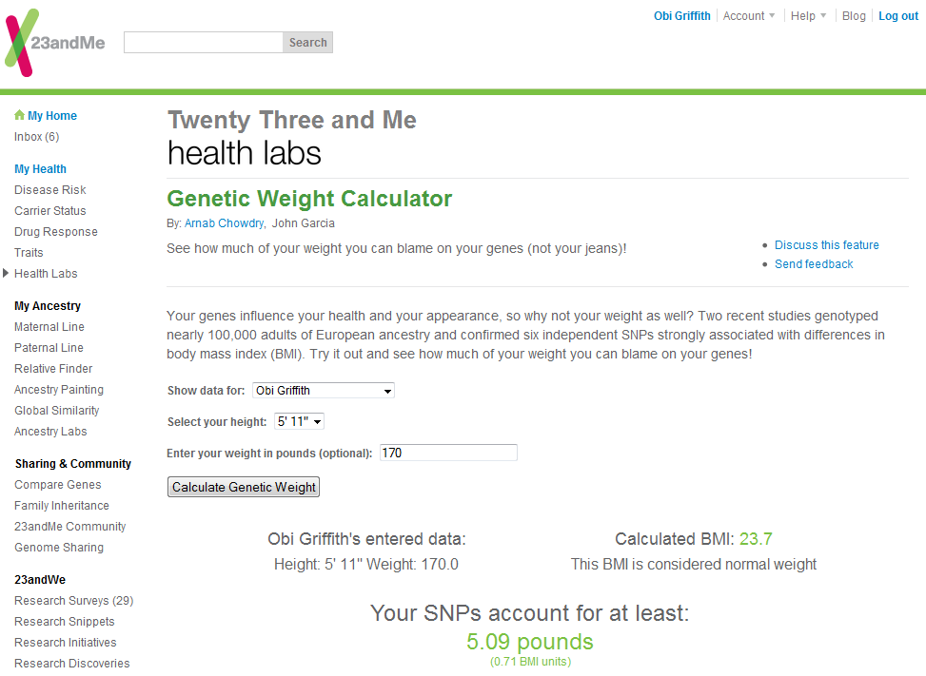
“Health Labs”: Extra five pounds not my fault

Slide 24

Disease risks - 33% chance of diabetes! Oh wait that’s just 1.3x average
Environmental factors (not considered by 23andMe) likely outweigh my increased risk due to genetics

Slide 25
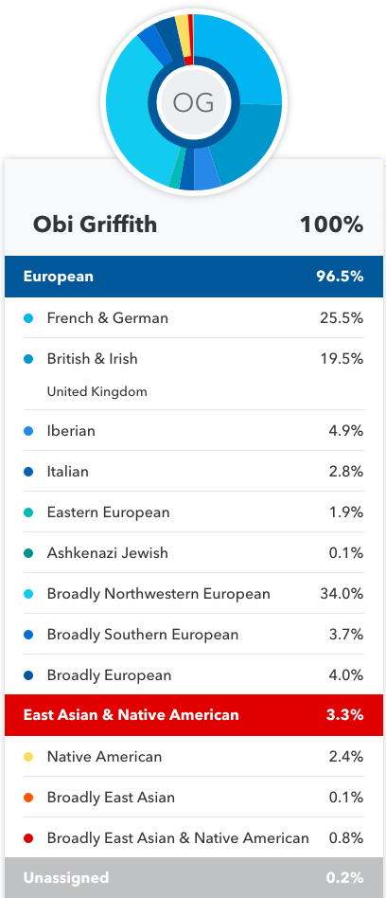
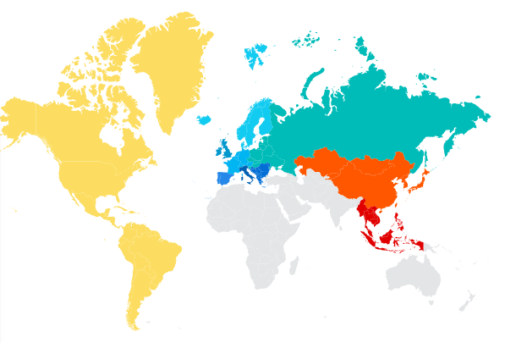
23andMe says – 96.5% European with 3.3% (East Asian & Native American)
Where did this Asian or Native American component come from?

Slide 26
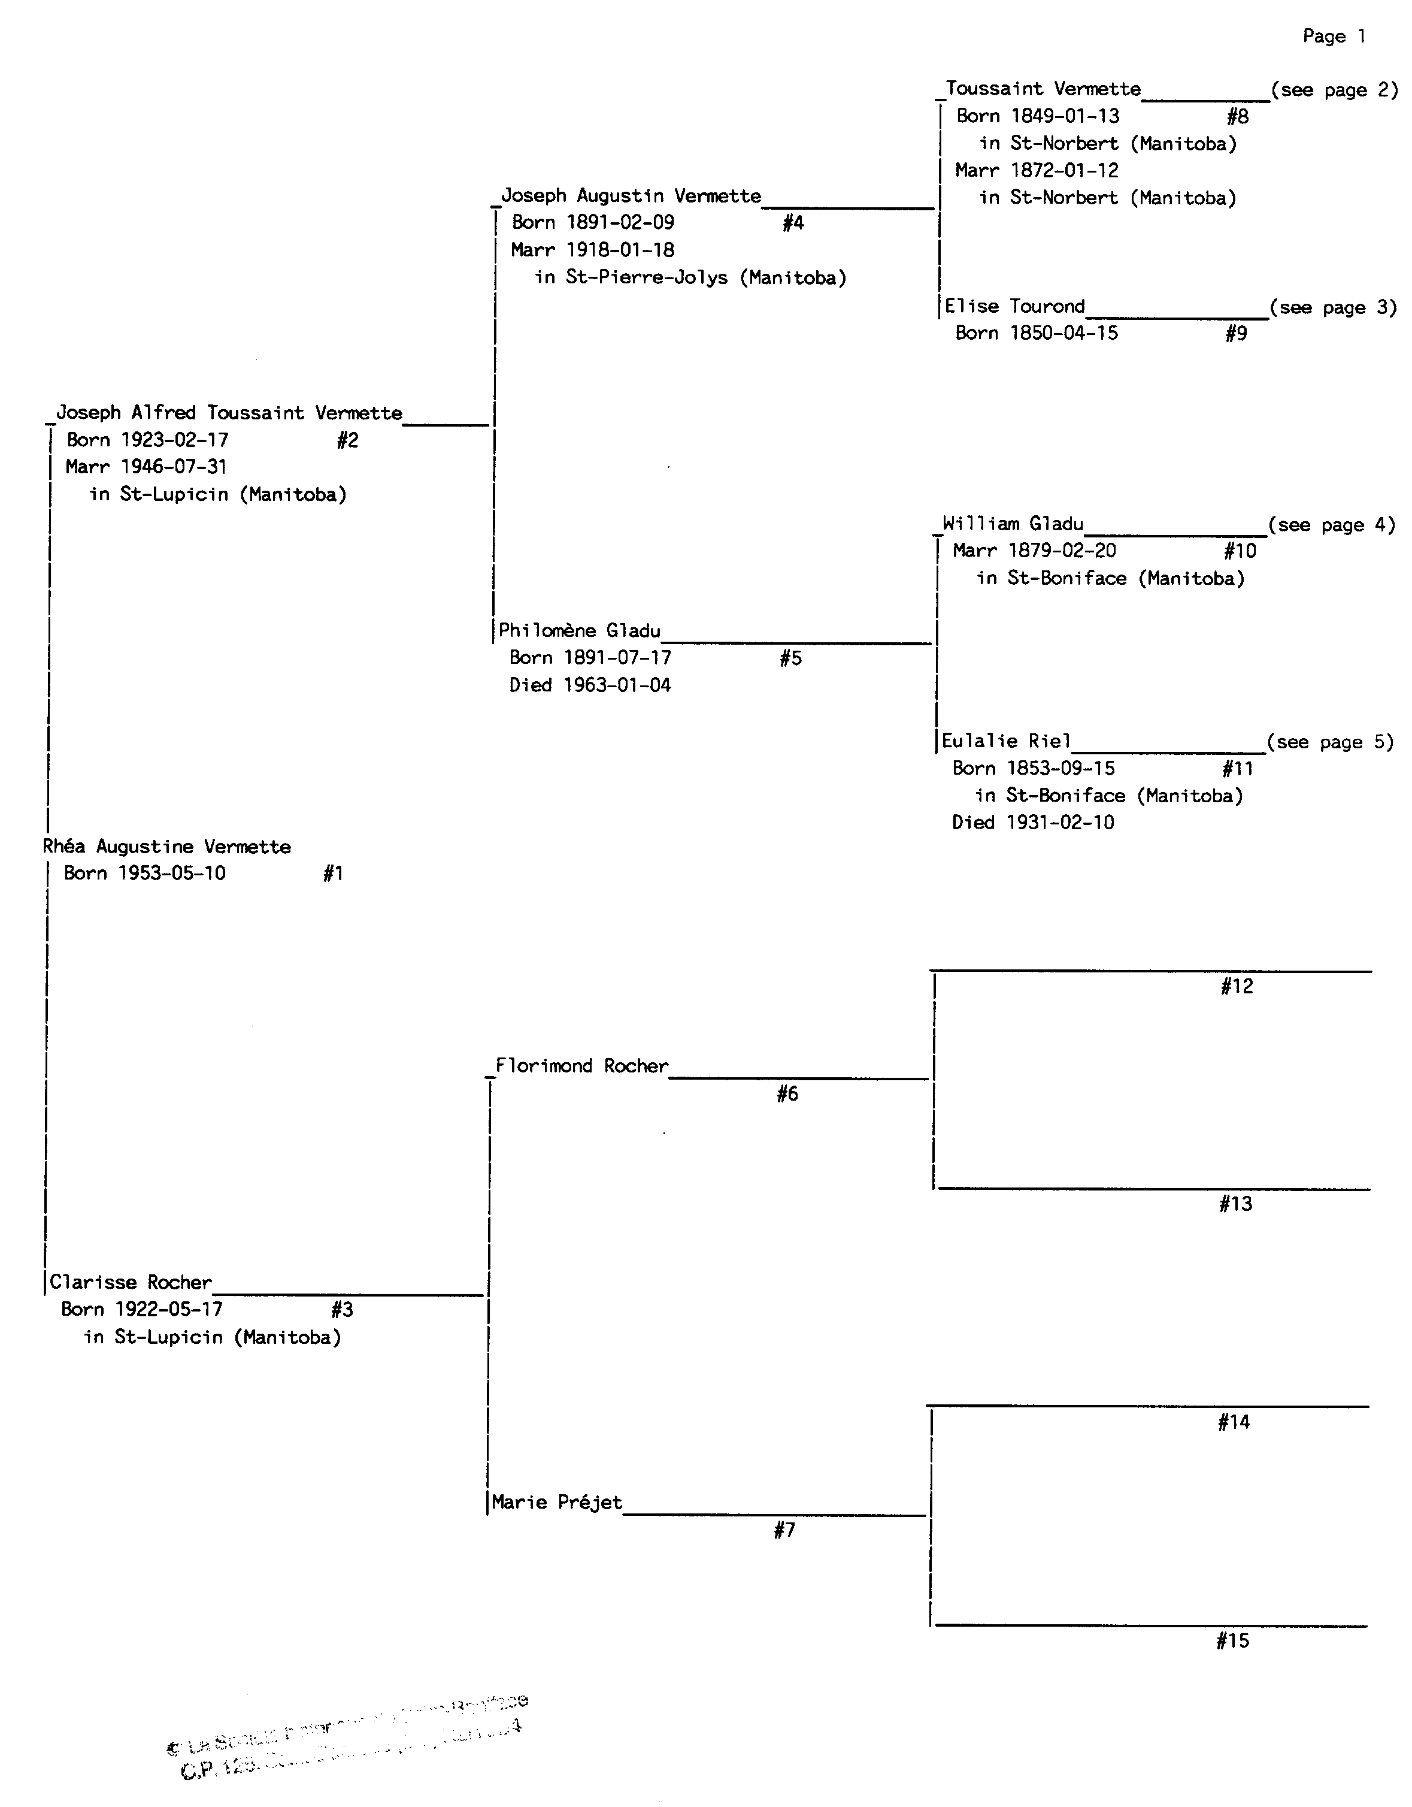
To the records office…
Grandfather
Starting from my mother’s name and birthdate, they were able to provide 71 pages of ancestry tracing as far back as 1574 France
Mother
Grandmother
The Société historique de Saint-Boniface - an archives and research center dedicated to preserving, studying, disseminating and promoting the francophone and Métis history of Manitoba and Western Canada.

Slide 27
To the records office…
Grandfather
Great-Grandmother
Great-Great-Grandmother
Mother

Slide 28
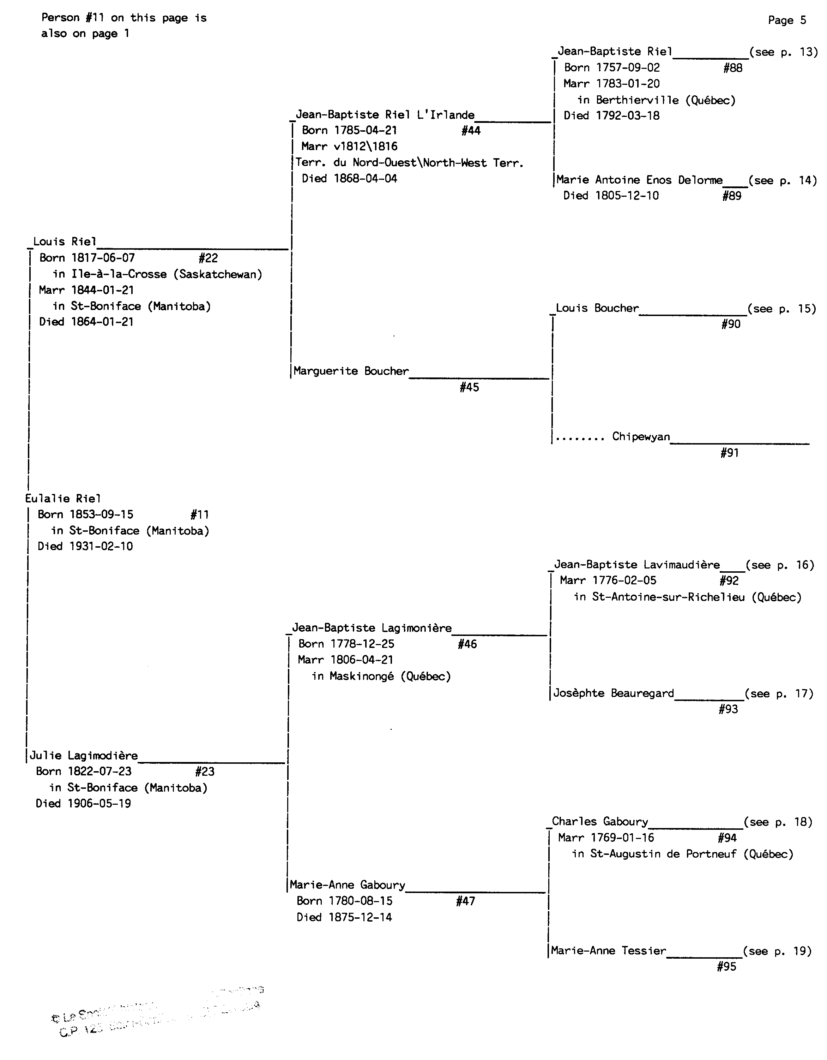
An historical aside…
Great-Great-Grandmother
Louis David Riel Born 1844-10-22
Died 1885-11-16

Slide 29
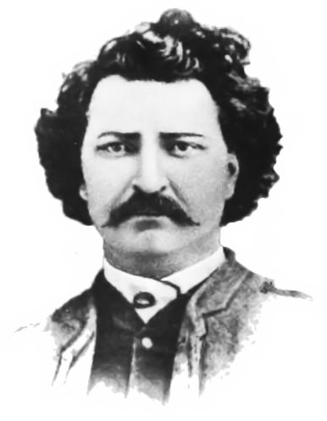
An historical aside…
Great-Great-Grand-Uncle Louis
a Canadian politician, founder of the province of Manitoba, and a political leader of the Métis people.
Sought to preserve Métis rights and culture
Now considered a folk hero by many.
Led two rebellions against the government of Canada.
While a fugitive, elected three times to the House of Commons of Canada
Came to believe that he was a divinely chosen leader and prophet
Arrested, convicted and hanged for high treason
Great-Great-Grandmother
Louis David Riel Born 1844-10-22
Died 1885-11-16

Slide 30
To the records office…
Great-Great-Grandmother

Slide 31
To the records office…
Great-Great-Great-Grandfather
Great-Great-Great-Great-Grandmother
Great-Great-Great-Great-Great-Grandmother
Great-Great-Grandmother

Slide 32
To the records office…
Great-Great-Great-Great-Great-Grandmother

Slide 33
My calculations (~0.8%) substantially less than 23andMe at 3.3%. Why the discrepancy?
25%
3.125%
50%
6.25%
100%
Me
1.5625%
12.5%
0.78125%
Other sources of Native American Ancestry?

Slide 34
To the records office…
Grandfather
Great-Grandmother
Great-Great-Grandmother
Mother

Slide 35
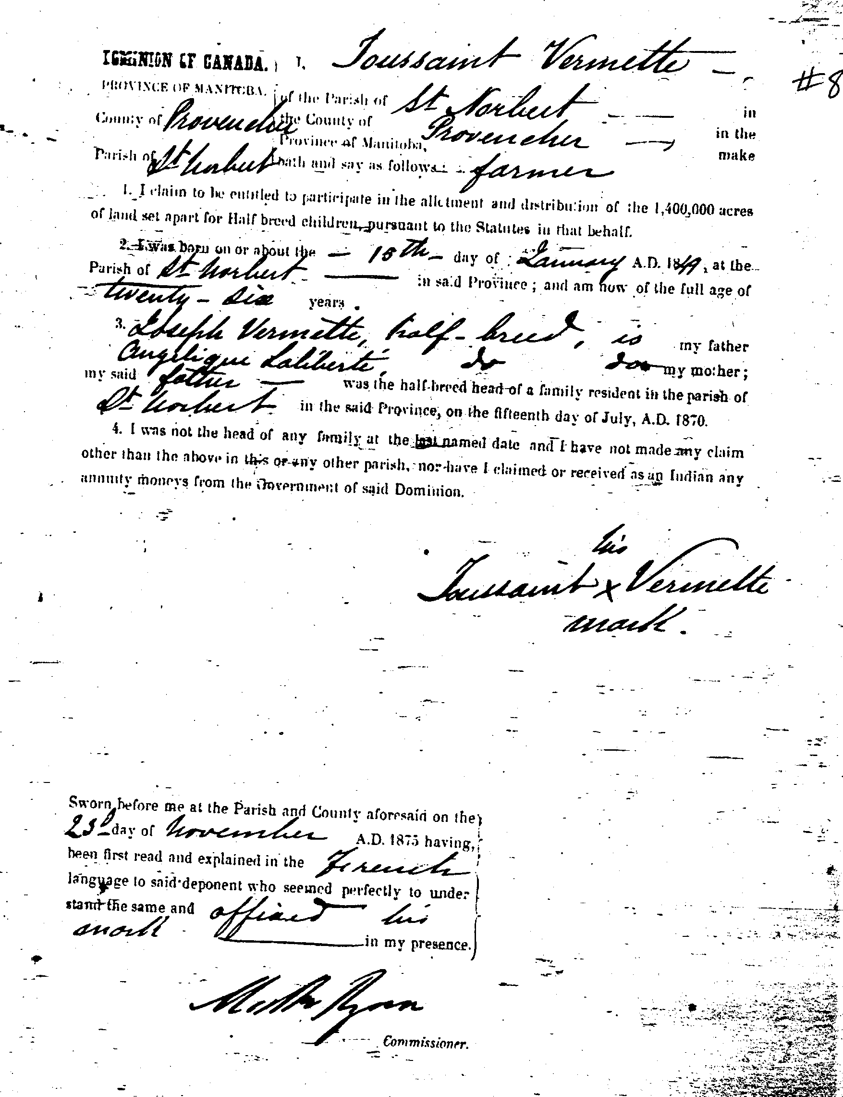
Records show at least one other great-great-grandfather had native ancestry
“I claim to be entitled to participate in the allotment and distribution of the 1,400,000 acres of land set apart for the Half breed children pursuant to the Statutes in that behalf”

Slide 36
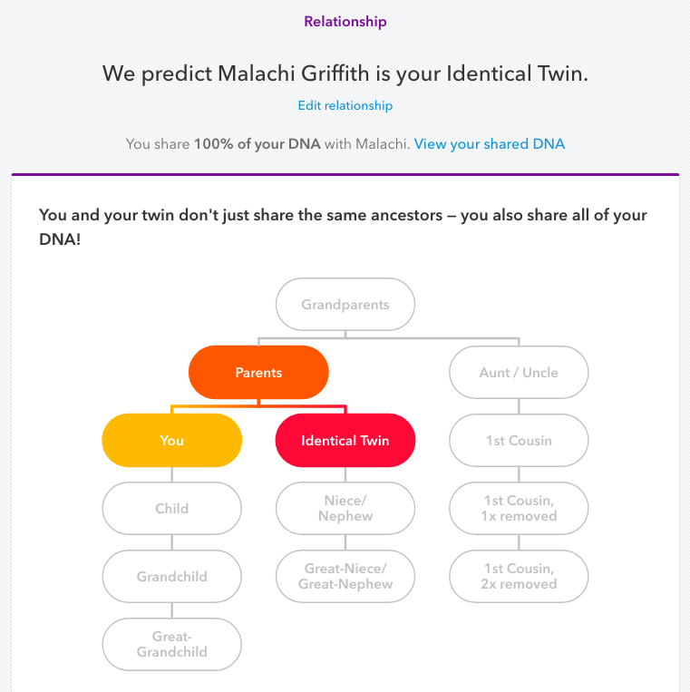
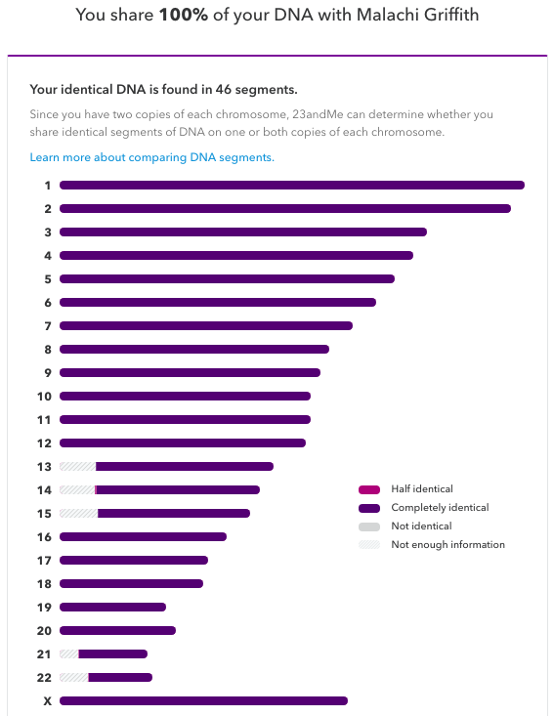
Comparing genes between Obi & Malachi: surprise – identical twins!

Slide 37
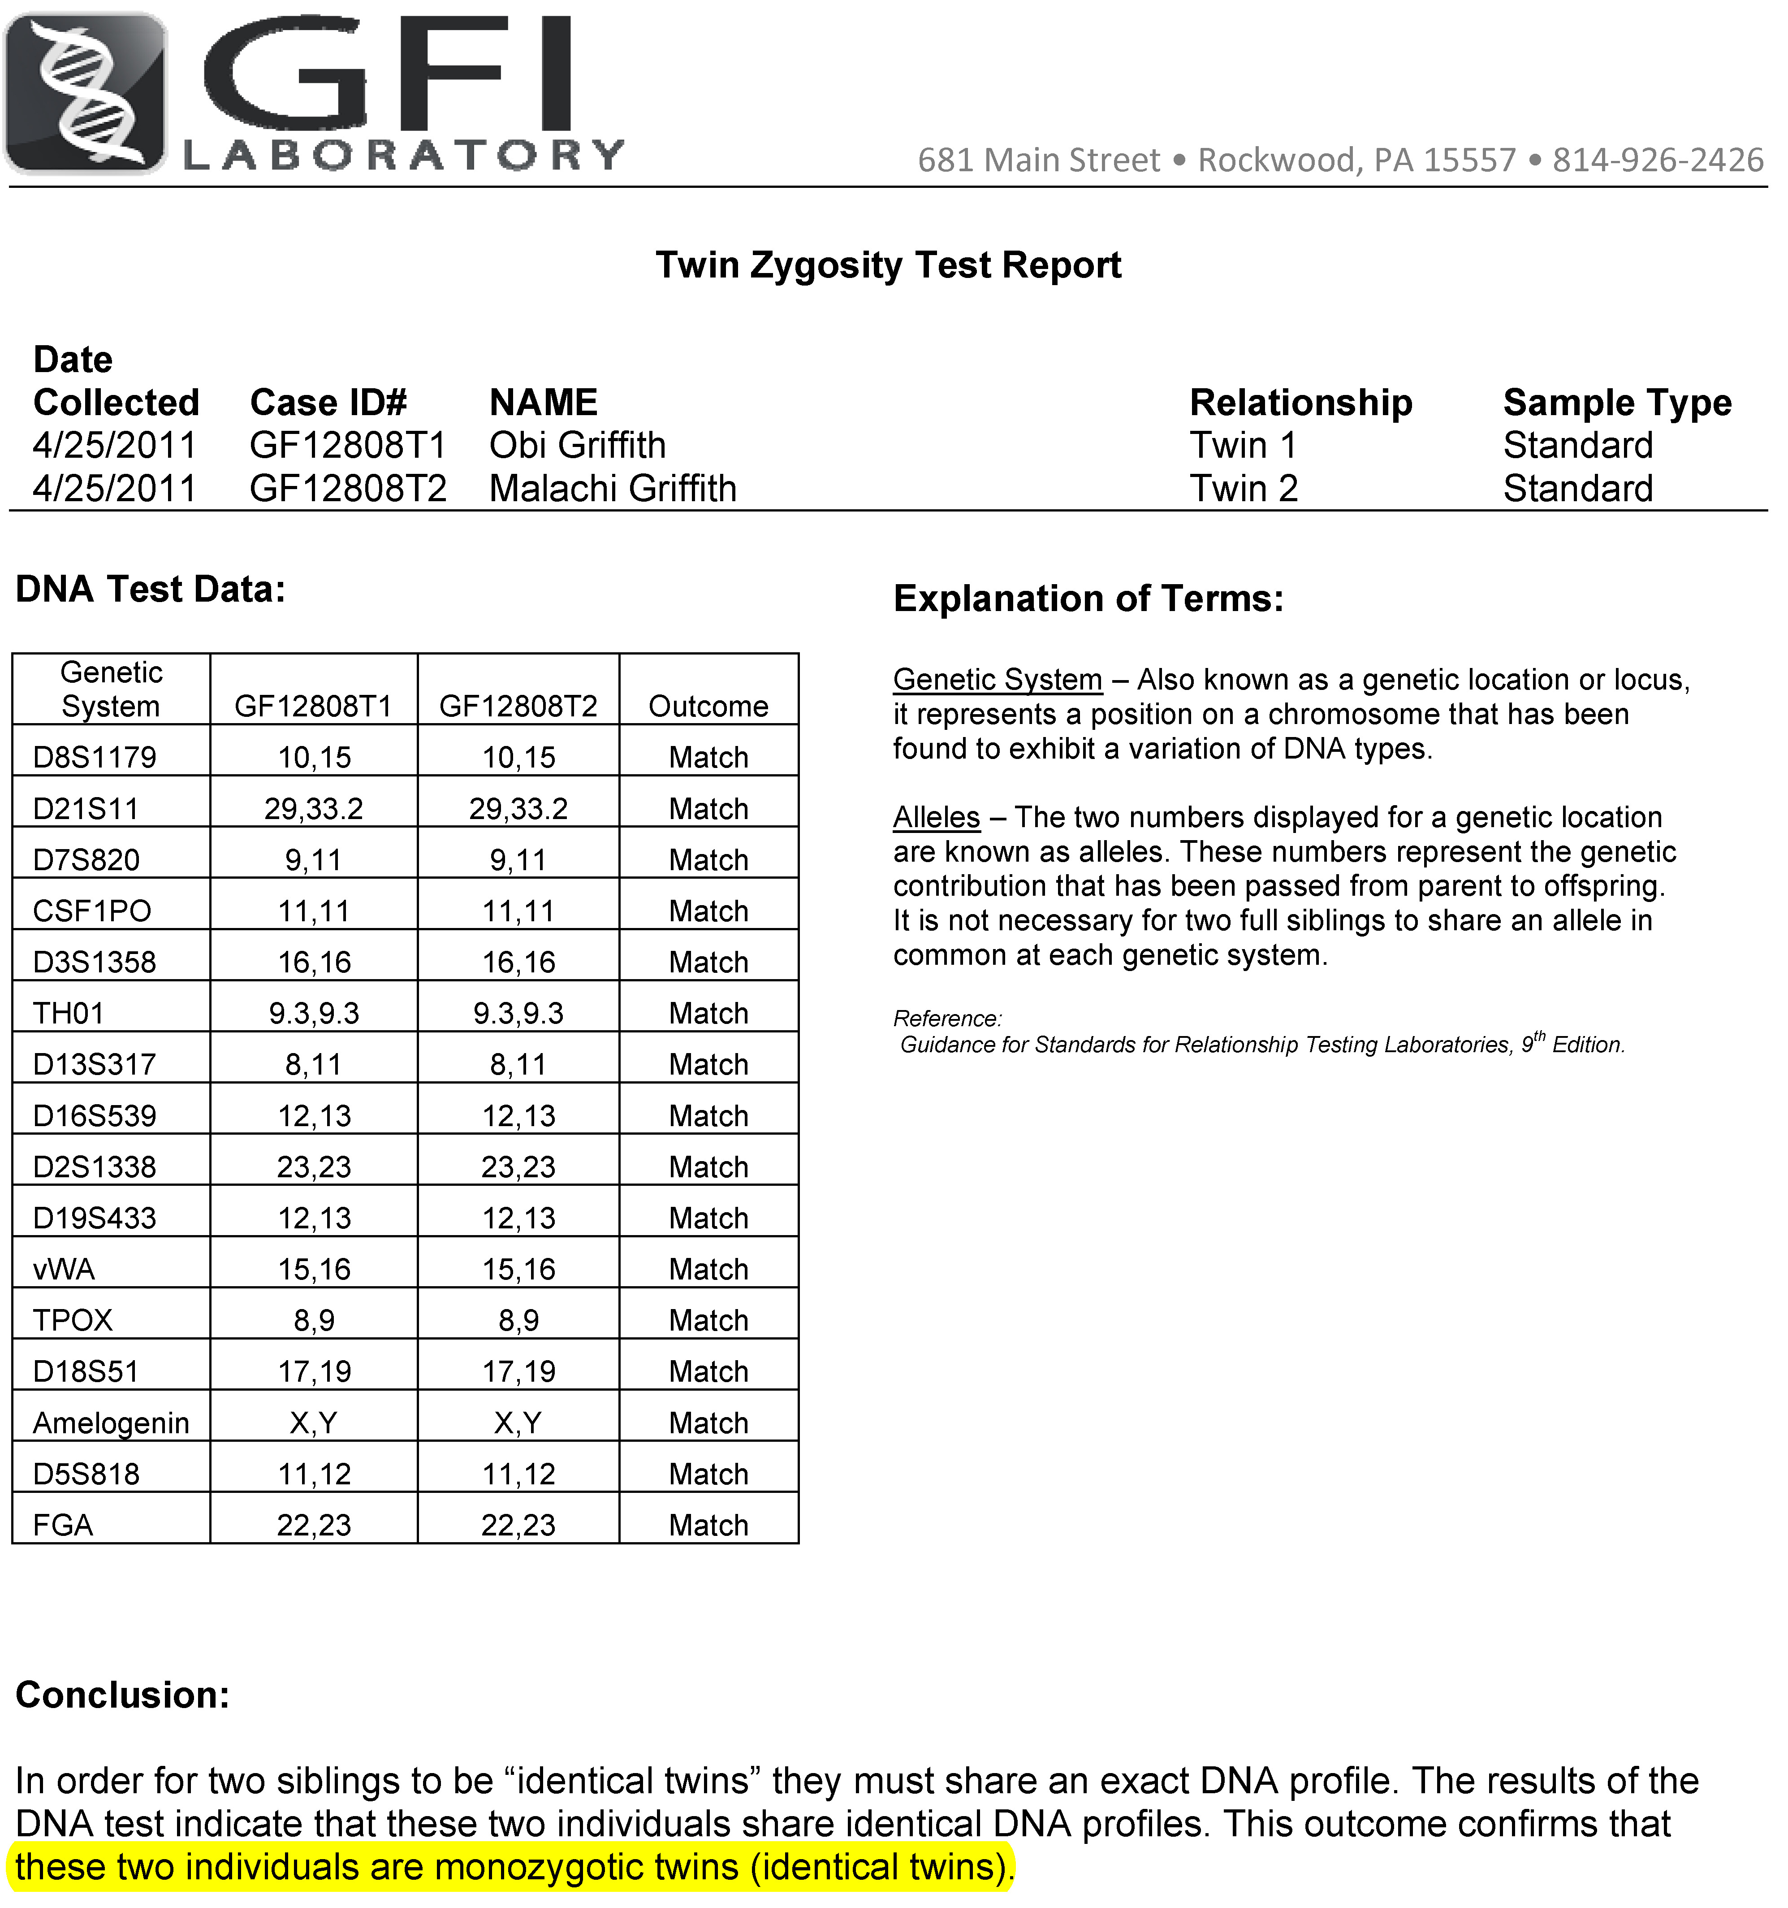
Independent test: Monozygosity confirmed!
How was wrong zygosity determined?
Gender – very accurate for diagnosing dizygotic (DZ) if different genders. No value for telling same gender DZ from MZ
Placental examination – MZ have same placenta ~80% of time. DZ twins can appear to have same placenta if similar implantation site.
~15% of identical twins think they are fraternal

Slide 38
23andMe allows you to download your raw data
Obi’s raw data
‘diff’ with Malachi
rsid | chromosome | position | Genotype
rs17163588 | 1 | 26322596 | CT
rs212964 | 1 | 48493745 | AG
rs533437 | 1 | 151386593 | CT
rs1336775 | 1 | 176231201 | AA
rs7594106 | 2 | 148089910 | AG
rs1004368 | 2 | 168350216 | AA
rs1560872 | 2 | 178935533 | AA
rs990672 | 2 | 229664562 | CT
rs7632996 | 3 | 5767135 | AA
rs17033759 | 3 | 10993680 | AG
rs1866773 | 3 | 29753247 | TT
… | … | … | …
rsid | chromosome | position | Obi | Malachi
rs2570006 | 3 | 5126637 | GT | --
rs7632996 | 3 | 5767135 | AA | GG
rs3804968 | 3 | 7477700 | CC | --
rs9874577 | 3 | 8728915 | -- | AA
rs370526 | 3 | 9045495 | CC | --
rs12490065 | 3 | 10602561 | -- | AG
rs17033759 | 3 | 10993680 | AG | AA
rs1797912 | 3 | 12445239 | AC | --
rs7650895 | 3 | 12450162 | -- | AA
rs9942108 | 3 | 14990337 | -- | AG
rs9825720 | 3 | 15390253 | -- | AG
… | … | … | … | …
966977 total SNPs
3242 differences (99.66% concordance)
959840 called for both twins
64 called differences (99.993% called concordance)
Approx. accuracy of platform

